Slide 1
Basal Ganglia and Thalamic Connections
Bruce Crosson, Ph.D.

Slide 2
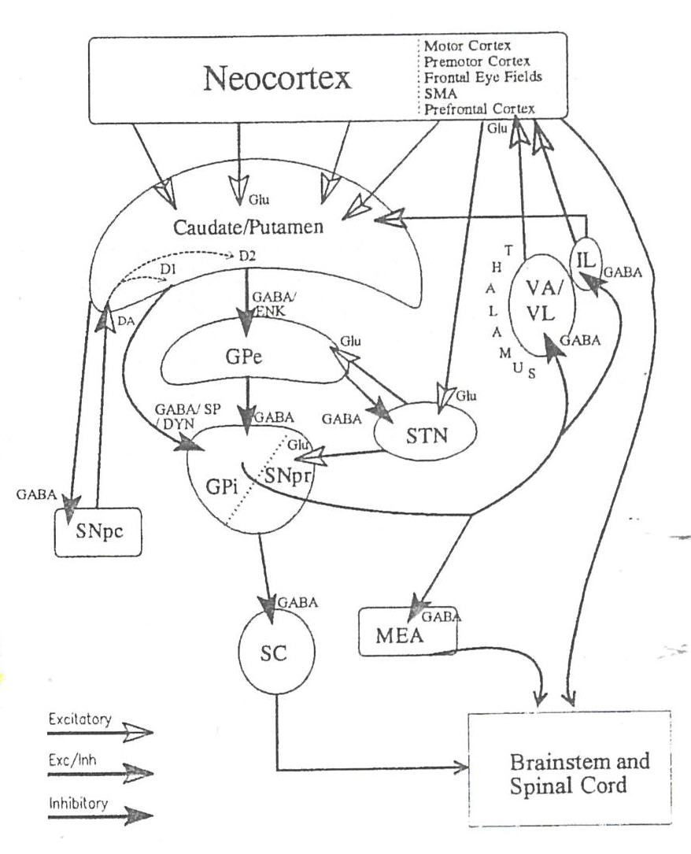
Here they are.
Any questions?
from Mink, 1996

Slide 3
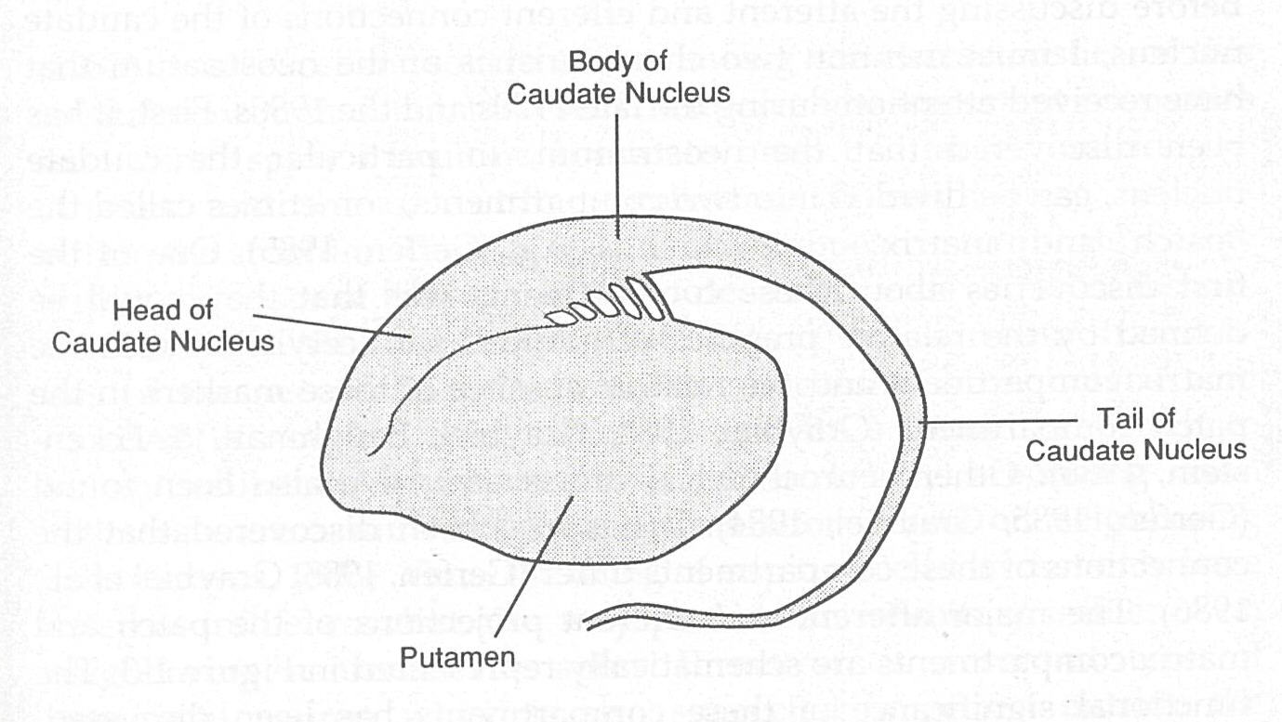
Amygdala
from Crosson, 1992

Slide 4
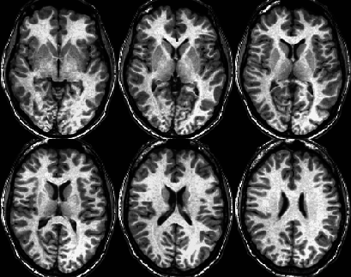
Basal Ganglia and Thalamic Anatomy: Axial View

Slide 5
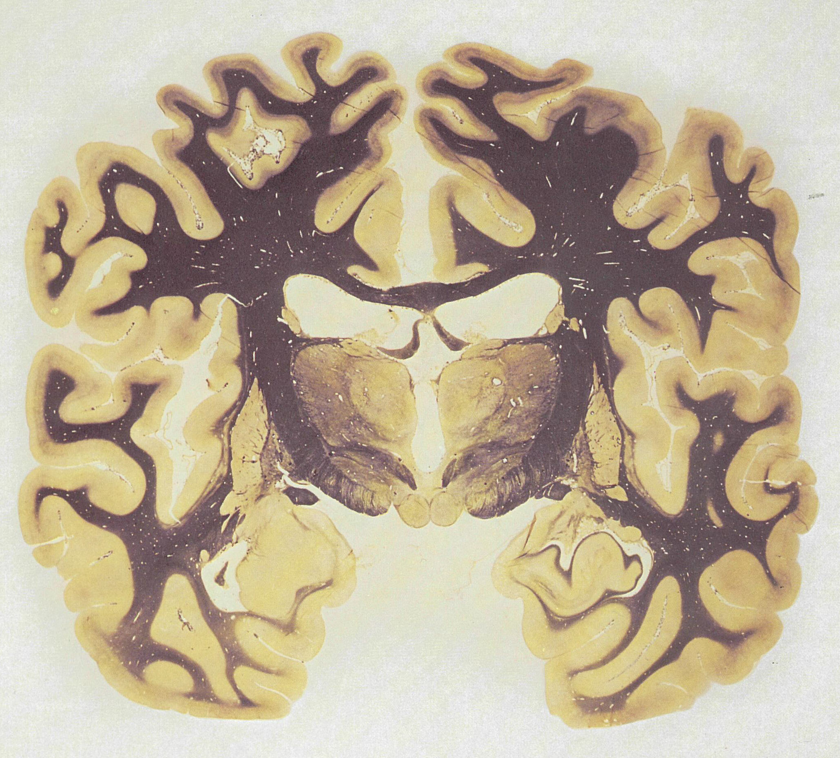
Subthalamic Nucleus
from Nauta & Feirtag, 1986

Slide 6
Frontal
Cortex
Posterior
Cortices
+
+
+
Striatum
+/-
Midbrain
DA
-
Globus Pallidus/
SN_{pr}
-
Thalamus
Alexander, DeLong, &
Strick (1986)

Slide 7
Frontal
Cortex
Posterior
Cortices
+
+
+
Striatum
+/-
Midbrain
DA
-
Globus Pallidus/
SN_{pr}
-
Middleton &
Strick (2000)
Thalamus

Slide 8
Indirect Basal Ganglia Loop
Lateral
Globus Pallidus
GABA
Subthalamic
Nucleus
-
Medial
Globus Pallidus
+
Glu

Slide 9
Modeling Activity in the Pre-SMA Loop
+
+
Pre-SMA
+
Striatal
Bridges
-
Medial
Globus
Pallidus
-
Ventral Ant.
Thalamus
-
+
Lateral
Globus
Pallidus
-
Subthalamic
Nucleus
+

Slide 10

Dorsolateral
Prefrontal
Lateral
Orbitofrontal
Anterior
Cingulate
Motor
Oculomotor
Cortex
SMA
FEF
DLPF
LOF
ACA
Striatum
PUT
BCN
dlHCN
vmHCN
VS
Pallidum
vlGP
cdmGP
ldmGP
mdmGP
rlVP
Thalamus
VLo
VLm
VAmc
MDpl
VApc
MDpc
VAmc
MDmc
pmMD
Alexander, DeLong, & Strick, 1986

Slide 11
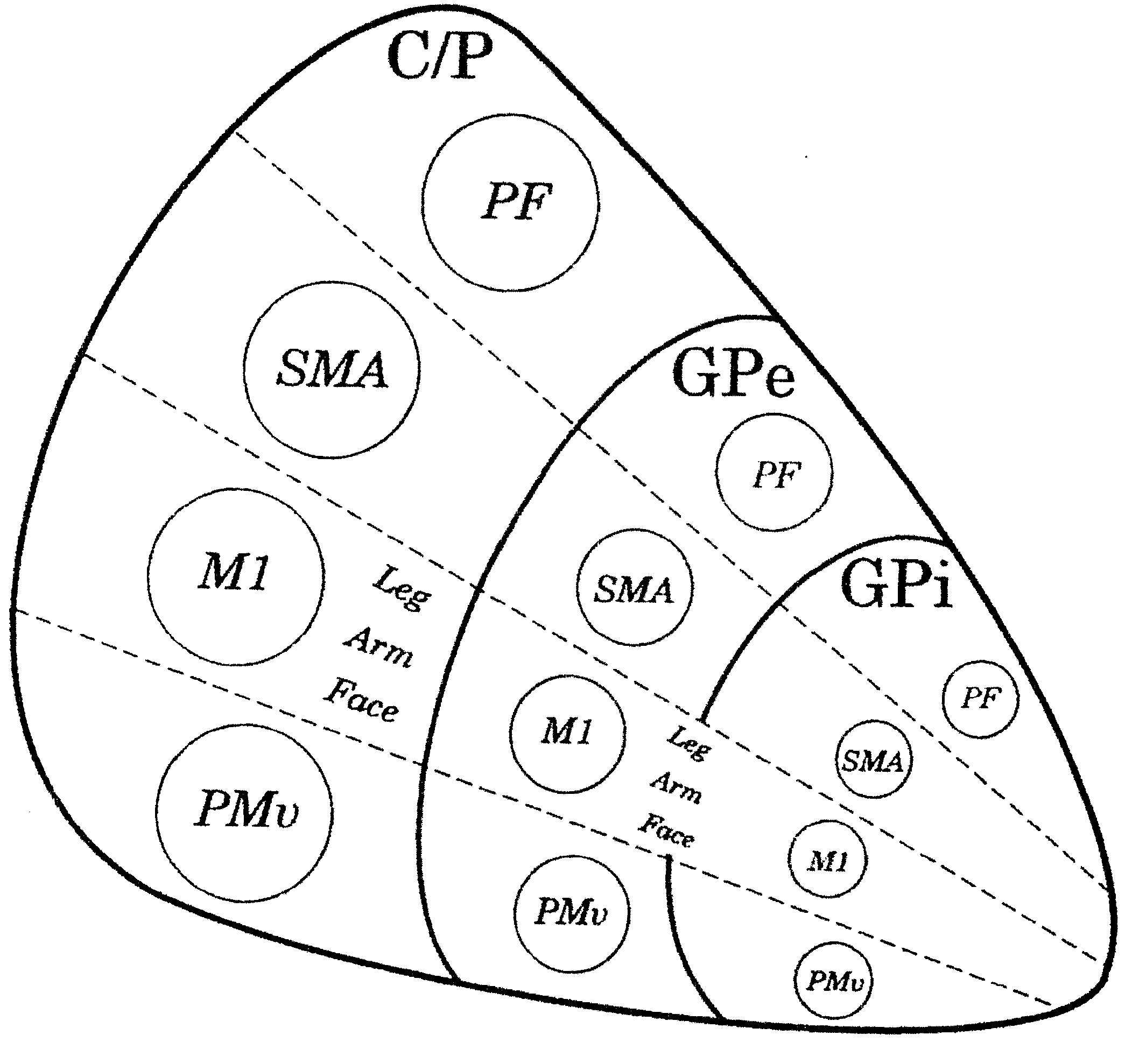
Motor Loops Studied
Strick, Dum, & Picard, 1995

Slide 12
Dorsolateral Prefrontal Cortex:
Executive Functions and Working Memory

Slide 13
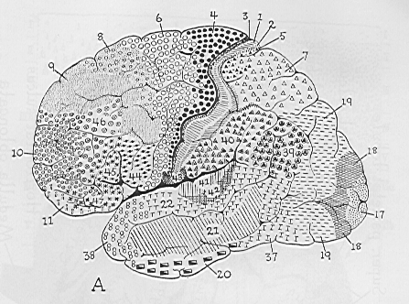
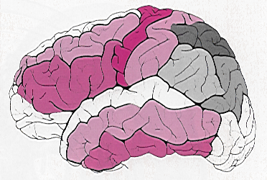
BA 9
BA 9
BA 46
Dorsolateral
Prefrontal
Cortex
from Mai et al., 1997

Slide 14
Dorsolateral Prefrontal Cortex:
Basal Ganglia Connections
Dorsolateral
Prefrontal
(BA9) Loop
Dorsolateral
Prefrontal
(BA 46) Loop
Dorsolateral
PFC
Dorsolateral
PFC
Dorsolateral
Caudate Head
Dorsolateral
Caudate Head
rd Globus
Pallidus
dm Globus
Pallidus
VA
Thalamus
VA & DM
Thalamus

Slide 15
Orbitofrontal Cortex:
Impulse Control

Slide 16
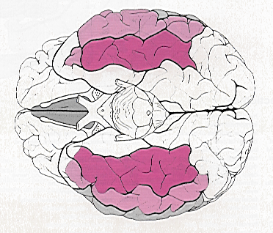
Lateral
Orbitofrontal
Cortex
Medial
Orbitofrontal
Cortex
from Mai et al., 1997

Slide 17
Orbitofrontal Cortex:
Basal Ganglia Connections
Lateral
Orbitofrontal
Loop
Medial
Orbitofrontal
Loop
Lateral
OFC
Medial
OFC
Ventromedial
Caudate Nuc.
Nucleus
Accumbens
Globus
Pallidus
Globus
Pallidus
Ventral Ant.
Thalamus
Ventral Ant.
Thalamus

Slide 18
Medial Frontal Cortex:
Initiation, Conflict Monitoring,
and Response Selection

Slide 19
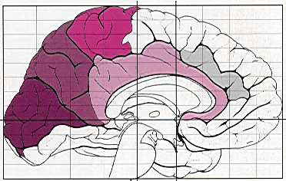
SMA
Posterior BA 6
Pre-SMA
Anterior BA 6
Rostral
Cingulate Zone
BA 32
Anterior
Cingulate Gyrus
BA 24
from Mai et al., 1997

Slide 20
SMA, Pre-SMA, and Rostral Cingulate Zone:
General Connectivity
SMA
Spinal
Cord
Posterior
Rostral
Cingulate Zone
Primary
Motor
Cortex
Anterior
Rostral
Cingulate Zone
Lateral
Premotor
Cortex
Pre-SMA
Lateral
Prefrontal
Cortex

Slide 21
Medial Frontal Cortex:
Basal Ganglia Connections
SMA
Loop
Anterior
Cingulate
Loop
Rostral
Cingulate
Loops
Pre-SMA
Loop
SMA
Pre-SMA
Anterior
Cingualte Gyrus
Rostral
Cingulate Zone
Putamen
Striatal
Bridges
Nucleus
Accumbens
?
Globus
Pallidus
Globus
Pallidus
Ventral
Pallidum
?
Ventral Lat.
Thalamus
Ventral Ant.
Thalamus
Dorsomedial
Thalamus
?

Slide 22
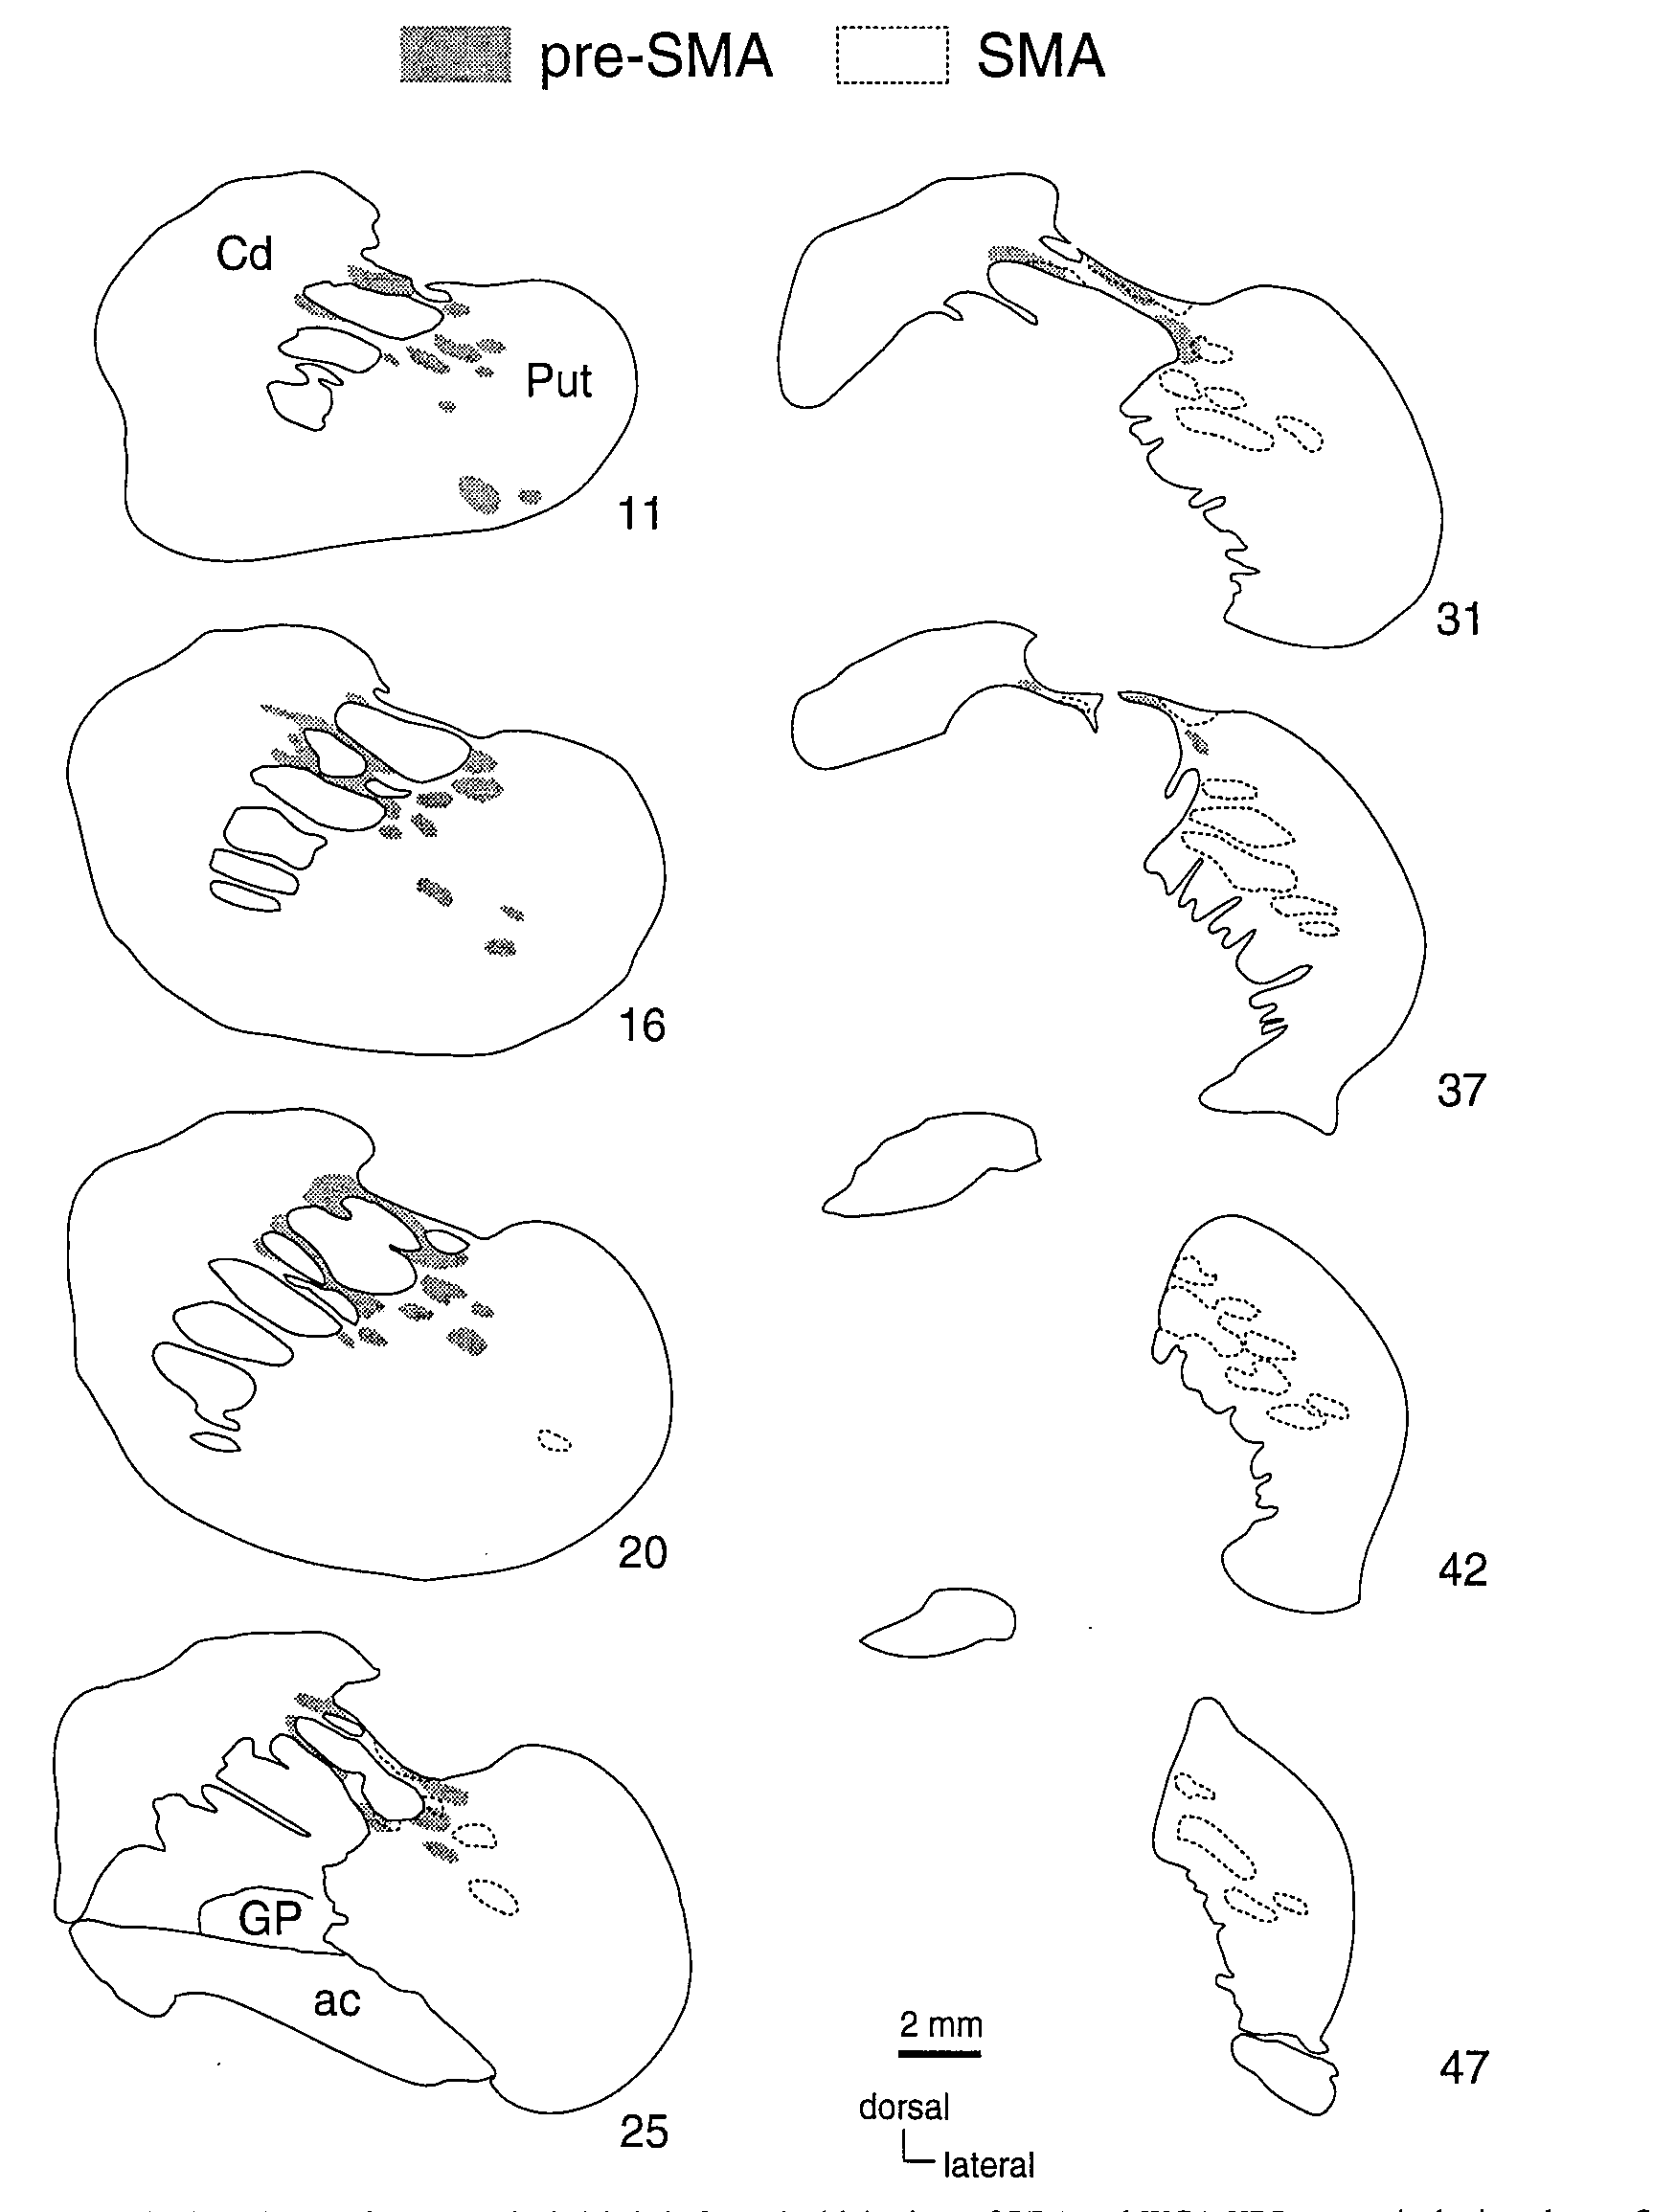
Striatal Projection
Areas for Pre-SMA
and SMA
Inase et al. (1999)

Slide 23
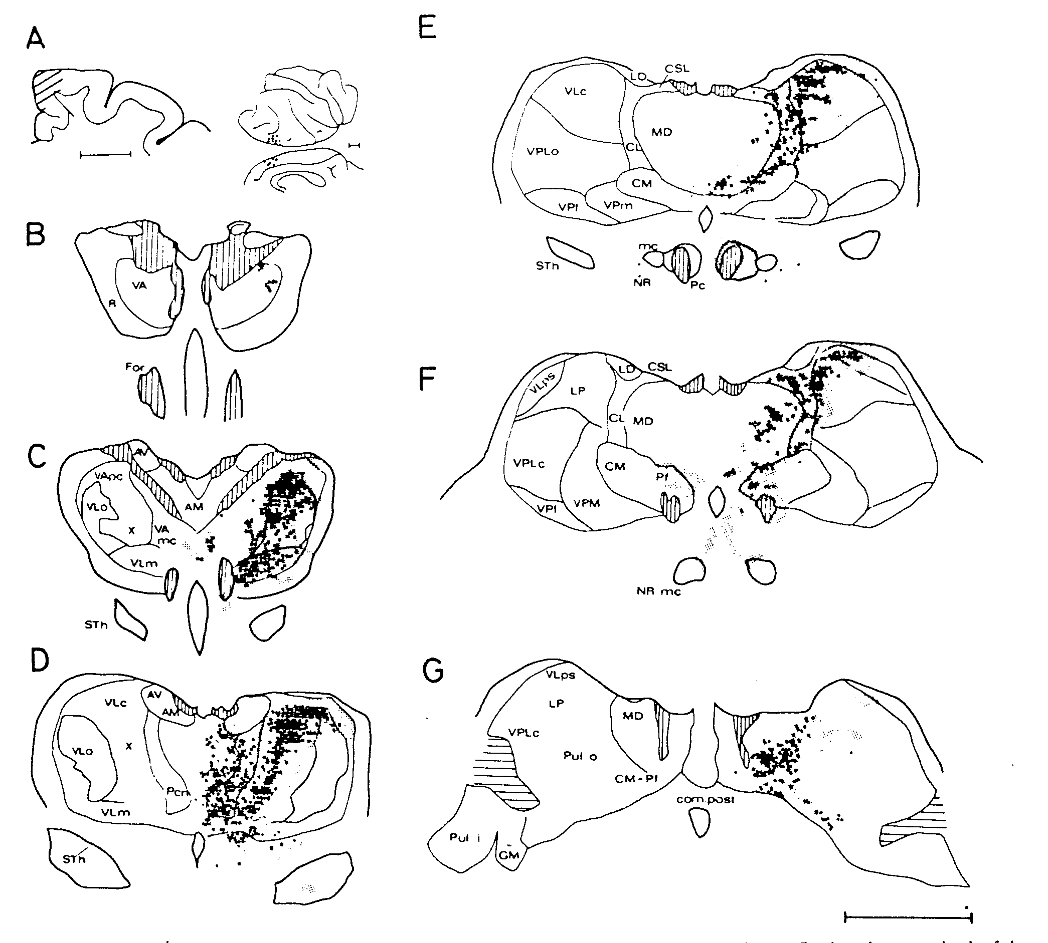
Pre-SMA Connections with the Thalamus
Wiesendanger & Wiesendanger, 1985

Slide 24
Posterior Inferior Frontal Gyrus:
Communication

Slide 25
Pars Opercularis
Pars Triangularis
from Mai et al., 1997

Slide 26
Broca’s Area
Broca’s
Area
?
?
?
Ullman, 2001

Slide 27
Internal Structure of the Striatum

Slide 28
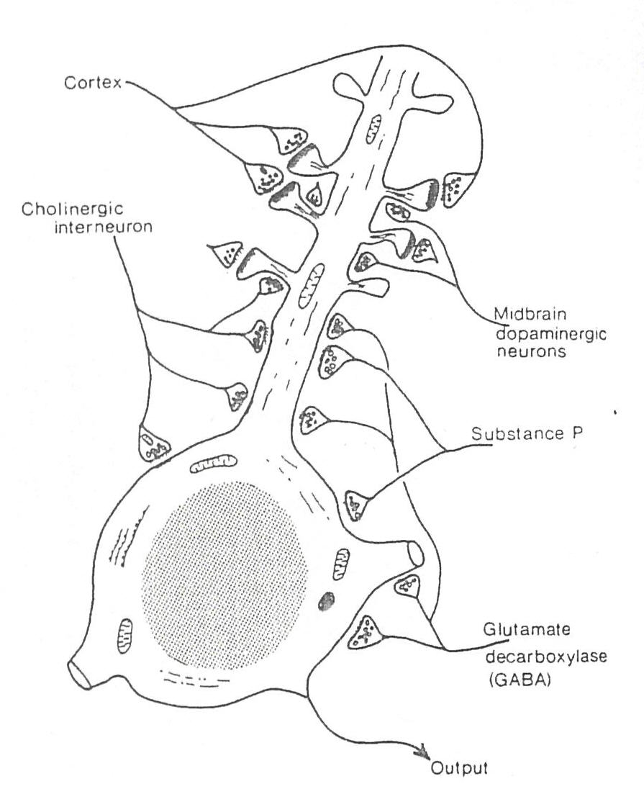
Striatal Medium Spiny Neuron
from Mink, 1996

Slide 29
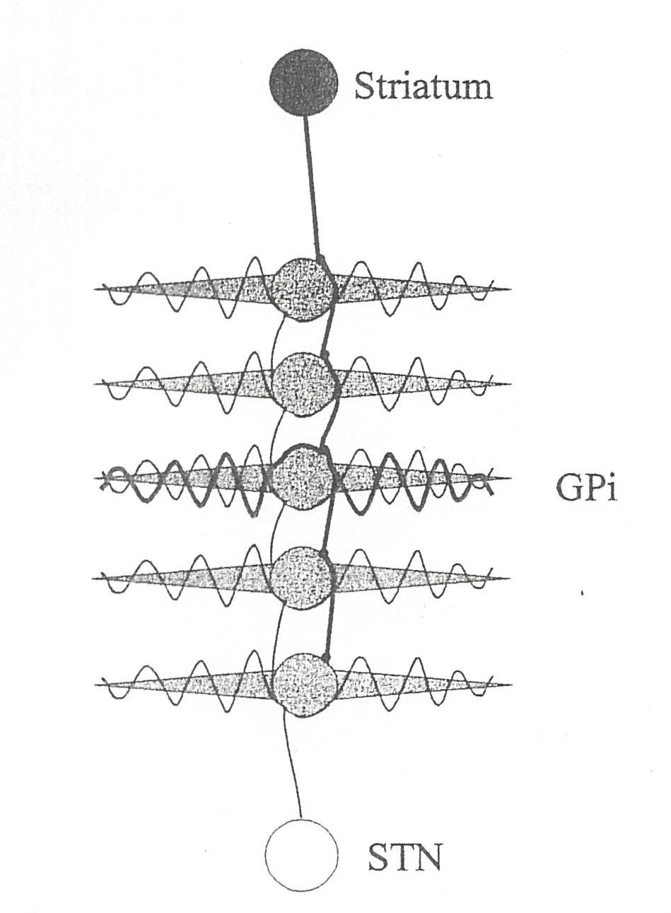
Medial Pallidal Projections from Striatum
and Subthalamic Nucleus
-
from Mink, 1996

Slide 30
Local Arborization of Medium Spiny Neuron Axons
in the Striatum
Striatum
Globus Pallidus
after Groves, 1993

Slide 31
Compartmentalization of Neostriatum
ACh
Neostriatal
Patch
Neostriatal
Matrix
MGP/
SNpr
LGP
SNpc
(DA)
Gerfen, 1985; Graybiel, 1984

Slide 32
Internal Structure of the
Globus Pallidus

Slide 33
Disk-Shaped Pallidal Dentric Fields
S
t
r
i
a
t
u
m
Globus
Pallidus
Per Yelnik et al., 1984

Slide 34
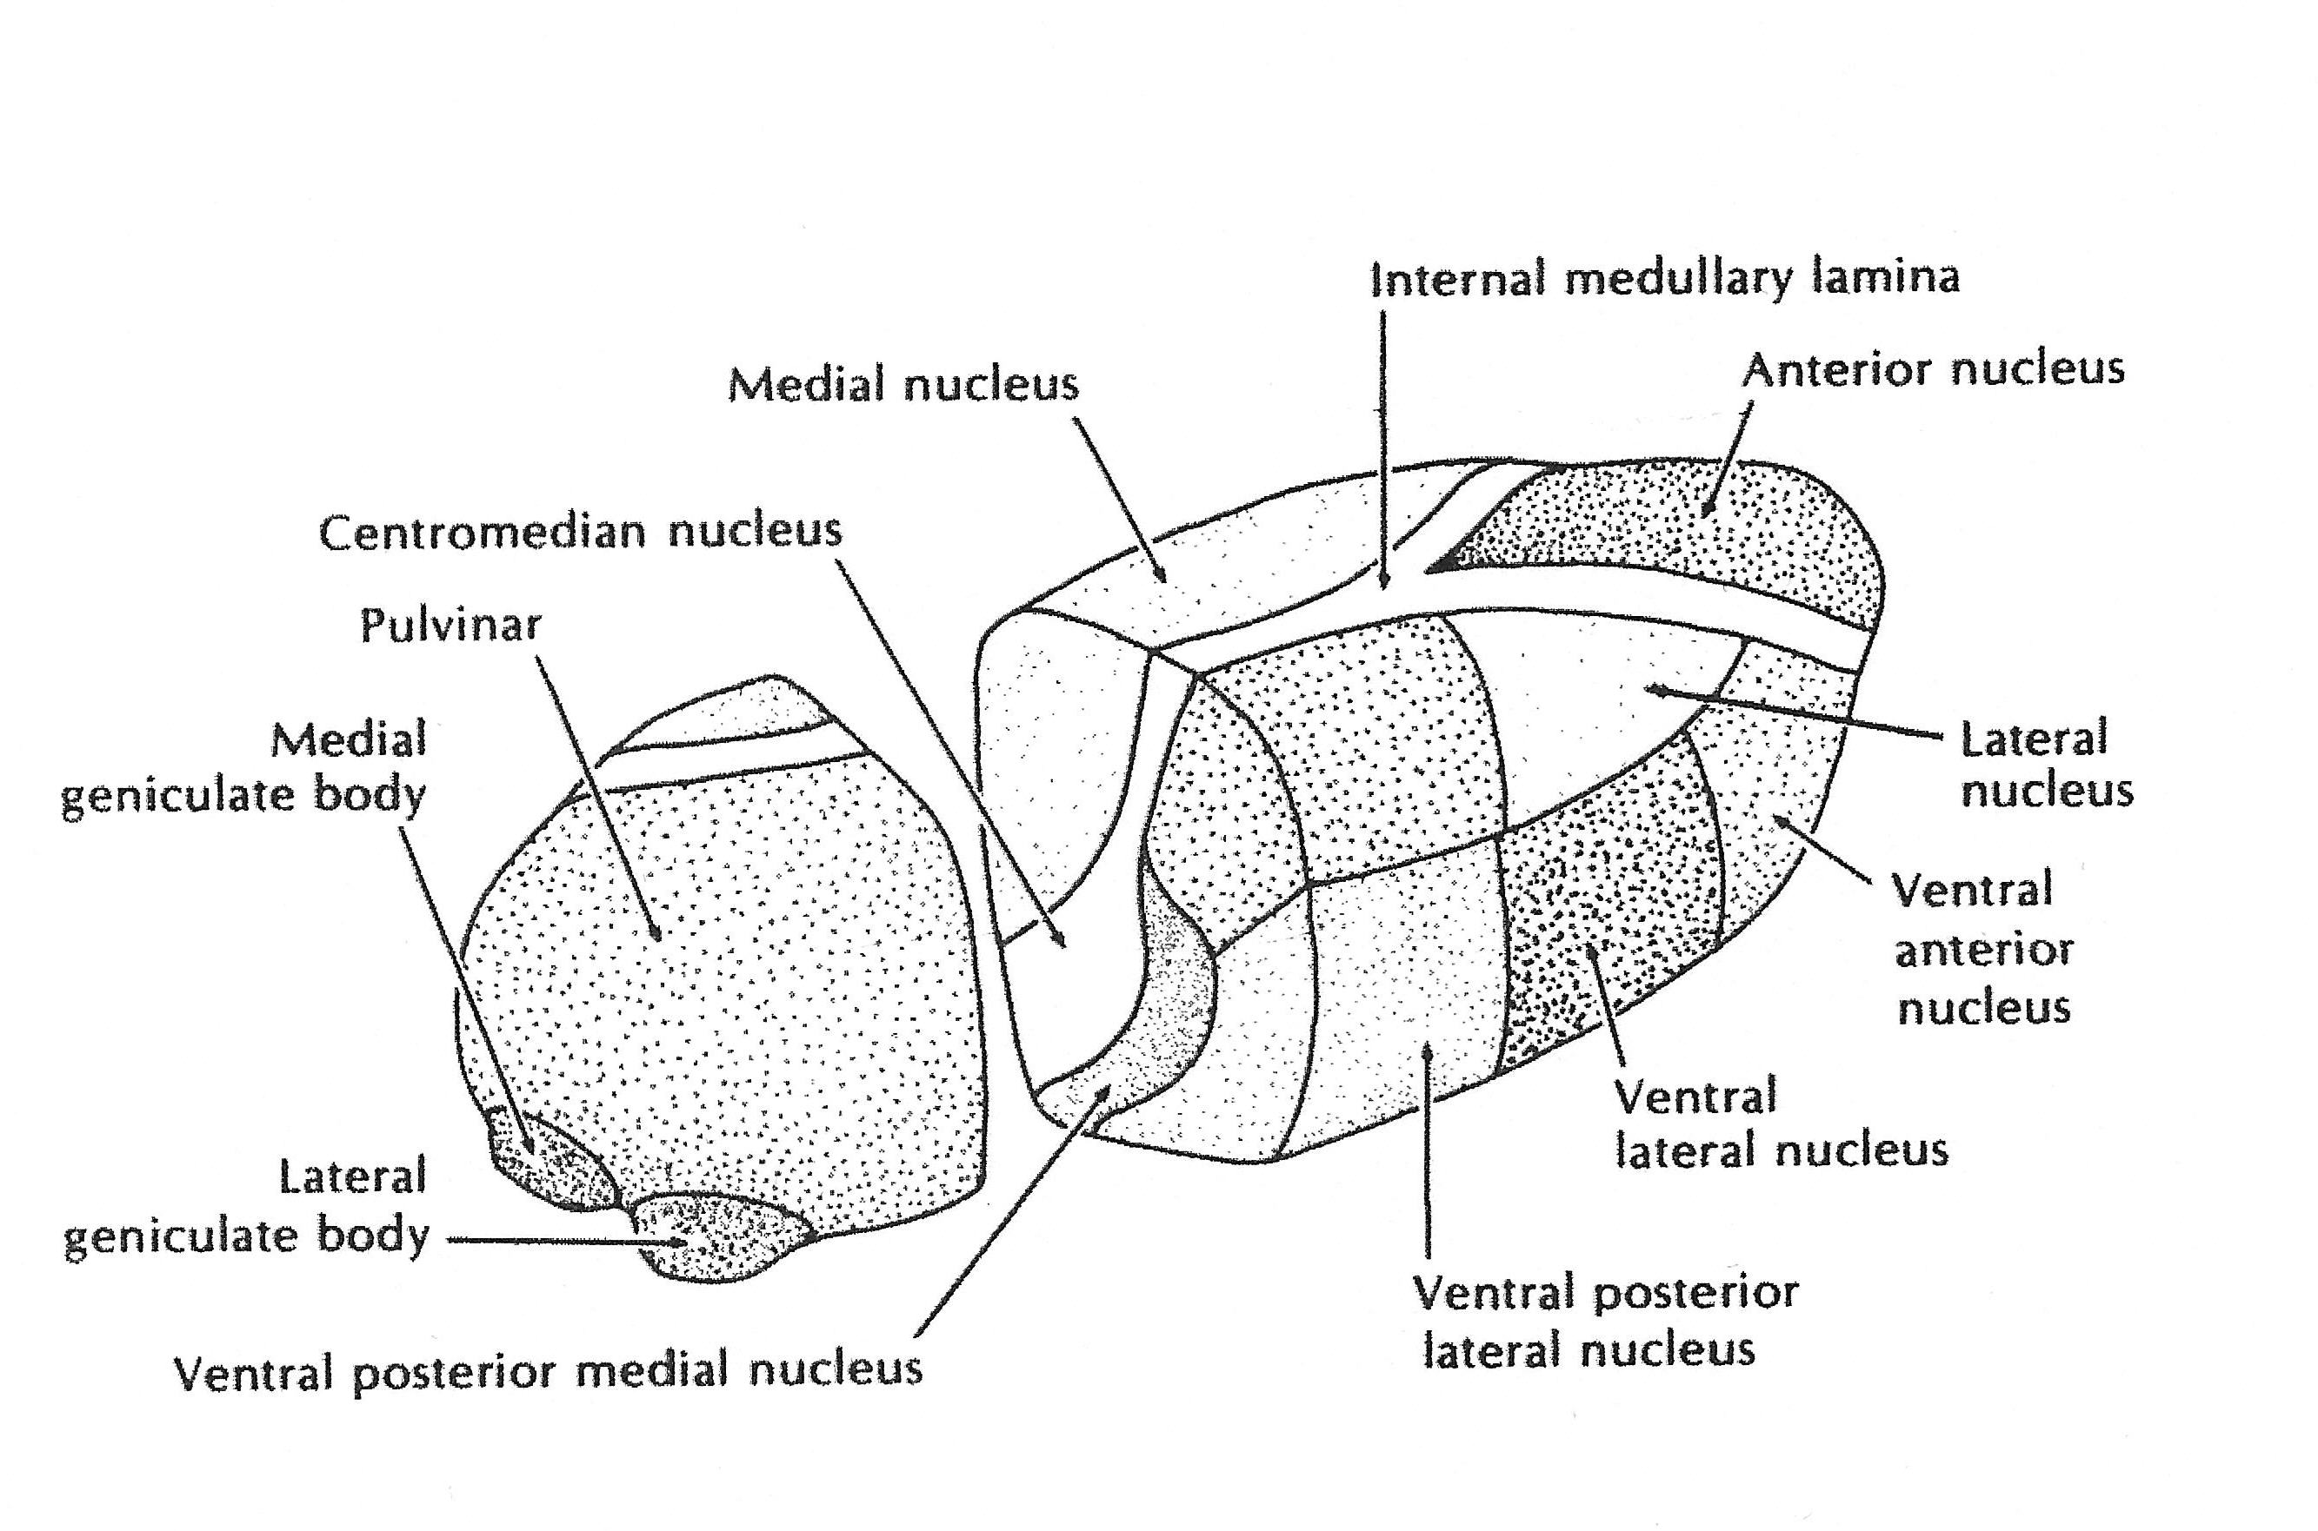
Thalamic Nuclei Associated with Basal Ganglia Loops (ventral anterior n., ventral lateral n., dorsal medial n.)
DORSAL
ANTERIOR
POSTERIOR
VENTRAL
Adapted from Matzke & Foltz, 1983

Slide 35
Cortex
Medial
Globus
Pallidus
Cortex
Striatum
Thalamus
D1
D2
Substantia
Nigra pars
compacta
Subthalamic
Nucleus
Focused Inhibition and
Surround of Excitation
in Medial Globus
Pallidus
Lateral
Globus
Pallidus
after Mink, 1996

Slide 36
Types of Thalamic Nuclei
by Cortical Connectivity
1. Motor (ventral lateral)
2. Sensory Relay (medial geniculate, lateral geniculate,
ventral posterior lateral, ventral posterior medial)
3. Association (ventral anterior, dorsal medial, pulvinar)
4. Limbic (anterior, dorsal medial)
5. Nonspecific (midline, intralaminar)
6. Nucleus Reticularis

Slide 37
Motor Thalamus (ventral lateral nucleus)
DORSAL
ANTERIOR
POSTERIOR
VENTRAL
Adapted from Matzke & Foltz, 1983

Slide 38
Thalamic Sensory Relay Nuclei (medial geniculate n., lateral geniculate n., ventral posterior lateral n., ventral posterior medial n.)
DORSAL
ANTERIOR
POSTERIOR
VENTRAL
Adapted from Matzke & Foltz, 1983

Slide 39
Thalamic Association Nuclei (ventral anterior n., dorsal medial n., pulvinar)
DORSAL
ANTERIOR
POSTERIOR
VENTRAL
Adapted from Matzke & Foltz, 1983

Slide 40
Limbic Thalamic Nuclei (anterior n., dorsal medial n.)
DORSAL
ANTERIOR
POSTERIOR
VENTRAL
Adapted from Matzke & Foltz, 1983

Slide 41
Nonspecific Thalamic Nuclei (midline nuclei, intralaminar nuclei)
DORSAL
Other
Intralaminar
Nuclei
ANTERIOR
POSTERIOR
VENTRAL
Adapted from Matzke & Foltz, 1983

Slide 42
Thalamic Nuclei Receiving Basal Ganglia Projections (ventral anterior n., ventral lateral n., dorsal medial n.)
DORSAL
ANTERIOR
POSTERIOR
VENTRAL
Adapted from Matzke & Foltz, 1983

Slide 43
Thalamic Nuclei Projecting to the Striatum (intralaminar nuclei)
DORSAL
Other
Intralaminar
Nuclei
ANTERIOR
POSTERIOR
VENTRAL
Adapted from Matzke & Foltz, 1983

Slide 44
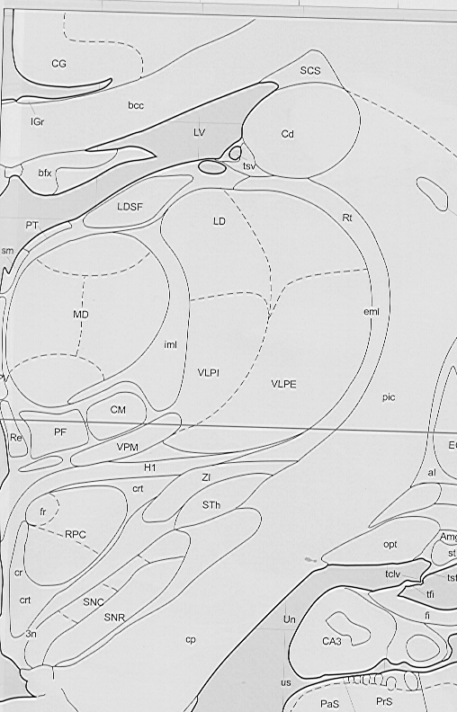
Nucleus Reticularis
Thalami (nr)
Mai, Assheuer, &
Paxinos (1997) Atlas
of the Human Brain.
San Diego: Academic
Press, #37.
nr

Slide 45
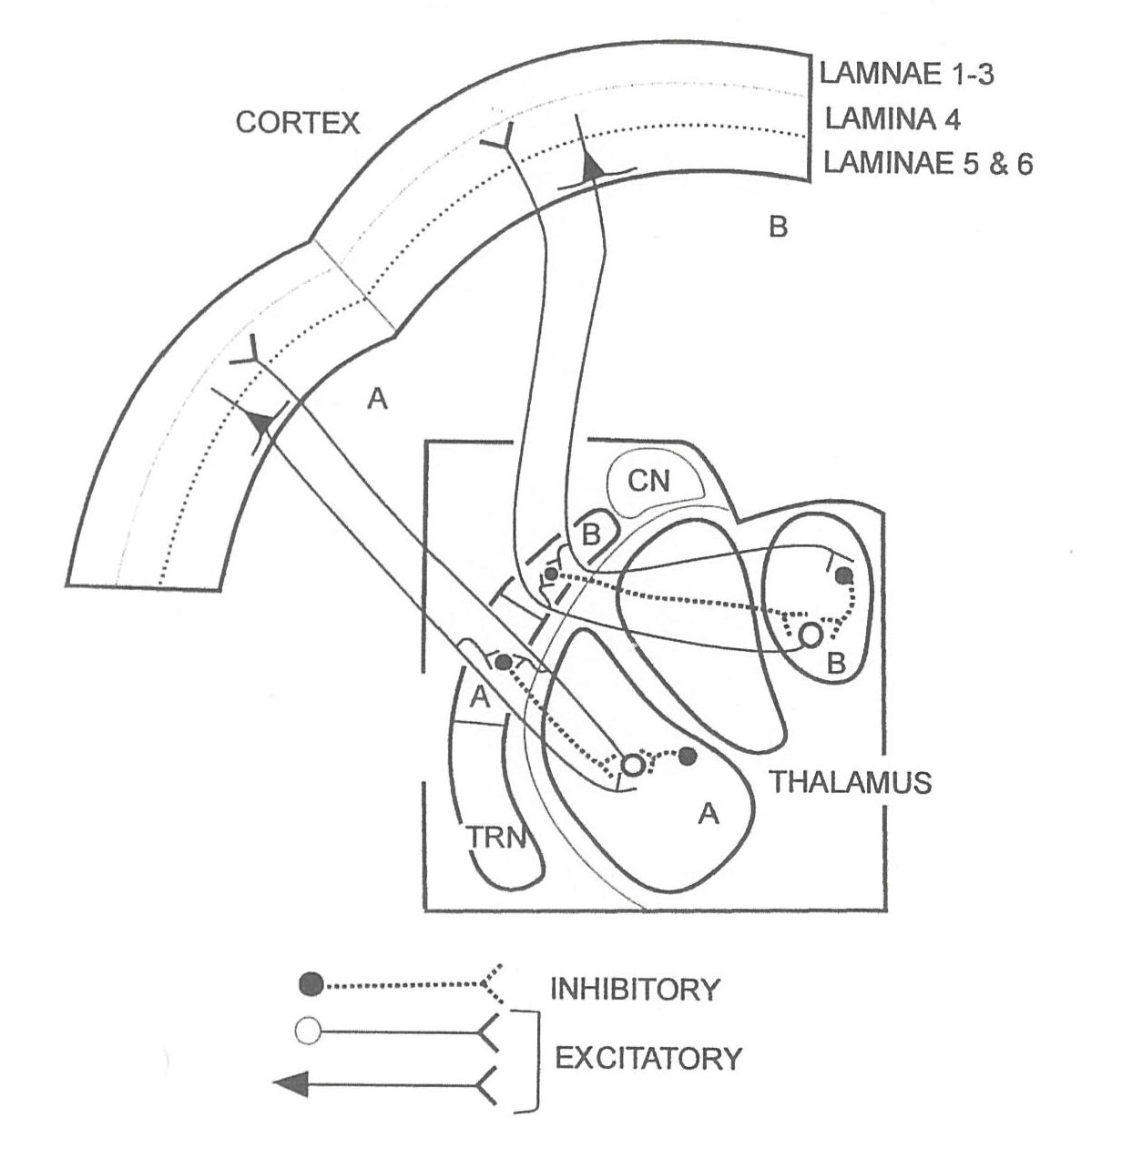
Cortex-Nucleus Reticularis-Thalamus Connections
from Sherman & Guillery, 2001

Slide 46
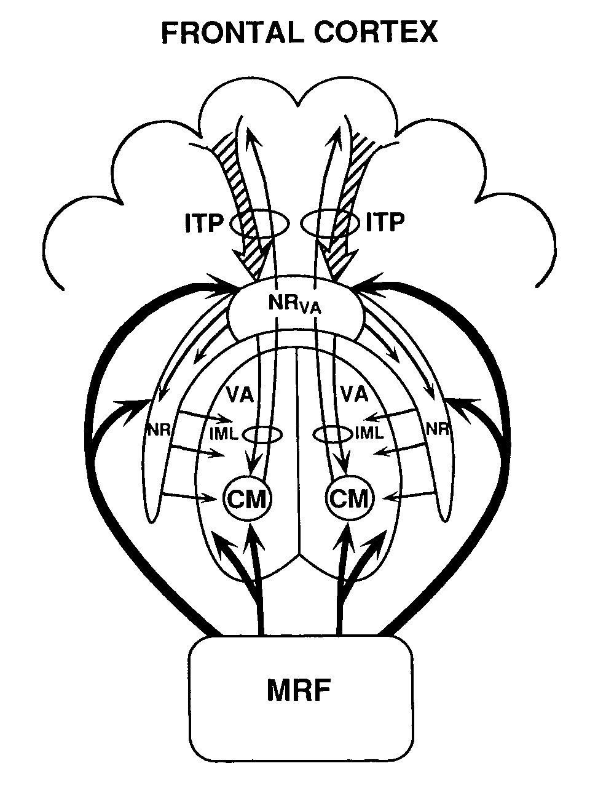

Slide 47
Inferior Temporal
Cortex
Anterior
Posterior
Spread of Activation Model with Categories
Chicken Pig Horse
Car Sled Boat
Farm Birds Fish
Animals
Vehicles Tools Buildings
Living
Non-
living
Tail Hooves Mane Large Rider Seats Wheels Engine
Selectively
Engaged
Nodes
Crosson © 2003

Slide 48
References
Alexander, G. E., DeLong, M. R., & Strick, P. L. (1986). Parallel organization of functionally segregated circuits linking basal ganglia and cortex. Annual Review of Neuroscience, 9, 357‑381.
Chow, T. W. & Cummings, J. L. (1999). Frontal-Subcortical Circuits. In B. L. Miller & J. L. Cummings (eds.), The Human Frontal Lobes: Functions and Disorders. (pp. 3-26). New York: Guilford Press.
Crosson, B. (1992). Subcortical Functions in Language and Memory. Chapter 1: Subcortical neuroanatomy and language (pp. 9‑41). New York: Guilford Publications, Inc.
Gerfen, C. R. (1985). The Neostriatal mosaic. 1. Compartmental organization of
projections from the striatum to the substantia nigra in the rat. Journal of Comparative
Neruology, 236, 454-476.
Graybiel, A. M. (1984). Neurochemically specified subsystems in the basal ganglia. In D. Evered & M. O’Conner (eds.), Functions of the Basal Ganglia. Proceedings of Ciba Foundation Symposium, 107. (pp. 114-149). Summit, NJ: Ciba.

Slide 49
References, cont’d
Groves, P.M. (1983). A theory of the functional organization of the neostriatum and the neostriatal control of voluntary movement. Brain Research Reviews, 5, 109-132.
Inase, M., Tokuno, H., Nambu, A., Akazawa, T., & Takada, M. (1999). Corticostriatal and corticosubthalamic input zones from the presupplementary motor area in the macaque monkey: Comparison with the input zones from the supplementary motor area. Brain Research, 833, 191-201.
Mai, J. K., Assheuer, J., & Paxinos, G. (1997). Atlas of the Human Brain. San Diego: Academic Press.
Matzke, H. A. & Foltz, F. M. (1983). Synopsis of Neuroanatomy. New York: Oxford University Press.
Middleton, F.A. & Strick, P.L. (2000). Basal ganglia and cerebellar loops: motor and cognitive circuits. Brain Research Review, 31, 236-250.
Mink, J. W. (1996). The basal ganglia: Focused Selection and Inhibition of Competing Motor Programs. Progress in Neurobiology, 50, 381-425.
Nadeau, S. E. & Crosson, B. (1997). Subcortical Aphasia. Brain and Language, 58, 355-402.

Slide 50
References, cont’d
Nauta, W. J. H. & Feirtag, M. (1986). Fundamental Neuroanatomy. Chapter 14: Frontal Sections (pp. 239‑279). New York: W. H. Freeman and Company.
Sherman, S. M. & Guillery, R. W. (2001). Exploring the Thalamus. San Diego: Academic Press.
Strick, P. L., Dum, R. P., & Picard, N. (1995). Macro-organization of the circuuits connecting the basal ganglia with the cortical motor areas. In J. C. Houk, J. L. Davis, & D. G. Beiser (eds.), Models of Information Processing in the Basal Ganglia. (pp. 117-130). Cambridge, MA: The MIT Press.
Ullman, M. T. (2001). The declarative/procedural model of lexicon and grammar. Journal of Psycholinguist Research, 30, 37-69.
Wiesendanger, R. & Wiesendanger, M. (1985). Thalamic connections with medial area 6 (supplementary motor cortex) in the monkey (Macaca fascicularis). Experimental Brain Research, 59, 91-104.
Yelnik, J., Percheron, B., & Francois, C. (1984). A golgi analysis of the primate globus pallidus. 2. Quantitative morphology and spatial orientation of dendritic arborizations. Journal of Comparative Neurology, 227, 200-213.

